Slide 1
TITANIC DATA ANALYISIS REPORT
Presented by
OVIE OKPAKA
JUNE 2026
LINKEDIN:
https://www.linkedin.com/in/ovieokpaka/

Slide 2
INTRODUCTION
The Titanic Passenger Analysis was developed to examine passenger demographics, survival patterns, travel class distribution, embarkation locations, and family relationships among passengers aboard the Titanic.
Dataset Overview
Total Passengers: 418
Survival Rate: 36.36%
Passengers with Siblings/Spouses: 134
Average Age: 29.99 years

Slide 3
Findings:
Total number of passengers who embarked was 418
Total number of passengers who survived was 152
Overall survival rate 36.36%
Female passengers demonstrated significantly higher survival rates than males.
No male passengers survived.
Most passengers traveled alone rather than with family members.
Southampton was the most common embarkation point.
Gender, passenger class, and age were significant factors influencing survival outcomes.

Slide 4
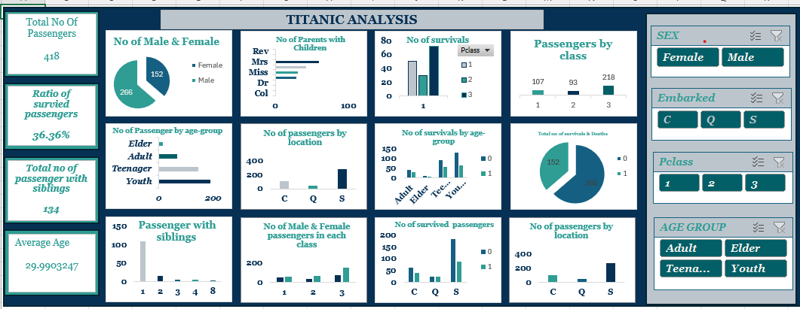
RESULTS

Slide 5
Conclusion
The analysis highlights the strong relationship between survival rates and demographic factors such as gender, age, and passenger class. Female passengers and individuals traveling in higher classes were more likely to survive, while male and third-class passengers faced greater risks.

Slide 6
Recommendation:
Prioritize vulnerable passengers during emergencies, evacuation should be based on passengers with health issues, aged passengers and children from zero (0) to fifteen (15) before anyone else.
Improve equal access to emergency resources
Enhance passenger safety awareness
Conduct frequent emergency drills for crew members
Improve data collection
Analysis should be carried out for risk management.

